Slide 1

Scheduling Soccer: Designing an Optimal Model for the Great NorthEast Atlantic Conference Soccer Fixtures
Segni Tulu, Ye Yint Win
MATH 328 - Operations Management

Slide 2

The Great Northeast Athletic Conference
NCAA Division III
13 Men’s teams and 14 women’s teams for the 2025 season.
This tool doesn’t include the Playoff Schedule, only the regular season.
Special Dates have specific college’s preferences: homecoming, alumni days, or special events that they want to have the teams at home.
Games happen on Tuesdays, Wednesdays, and Saturdays

Slide 3
Teams in GNAC
Teams | Team Name
AMC | Albertus Magnus College
CSC | Colby-Sawyer College
DC | Dean College
EC | Elms College
ENC | Emmanuel College
LU | Lasell University
MC | Mitchell College
NEC | New England College
NU | Norwich University
RU | Regis College
RRU | Rivier University
SJM | Saint Joseph's College of Maine
SMU | Simmons University
USJ | Saint Joseph University Connecticut
Tools Used
Rstudio
Excel
LpSolve
CBC solver from COIN-OR

Slide 4
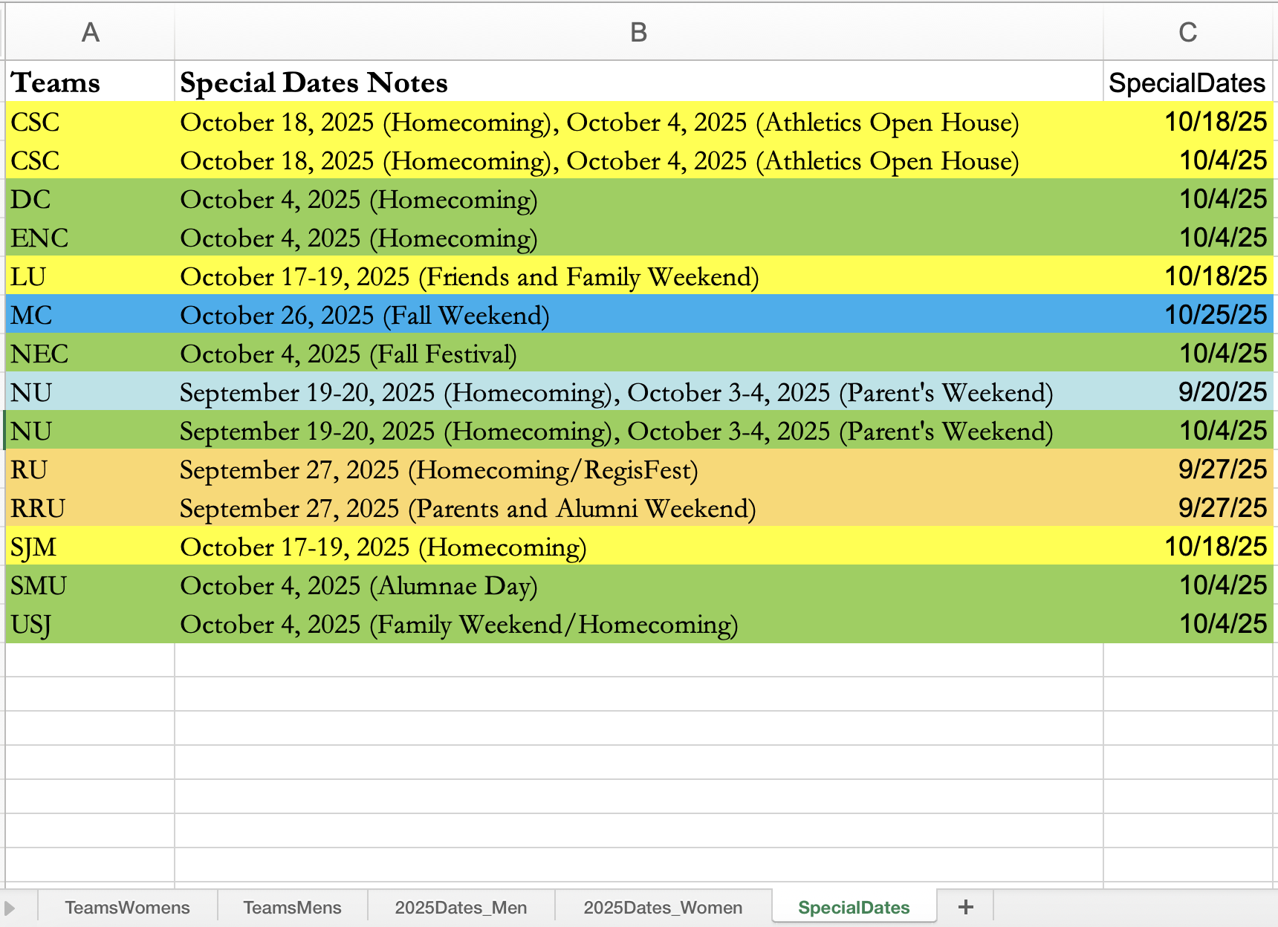
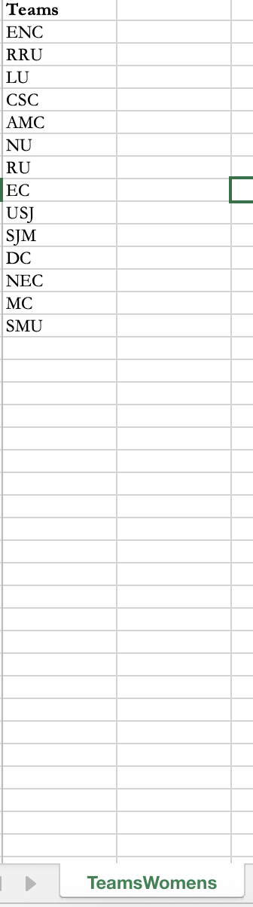
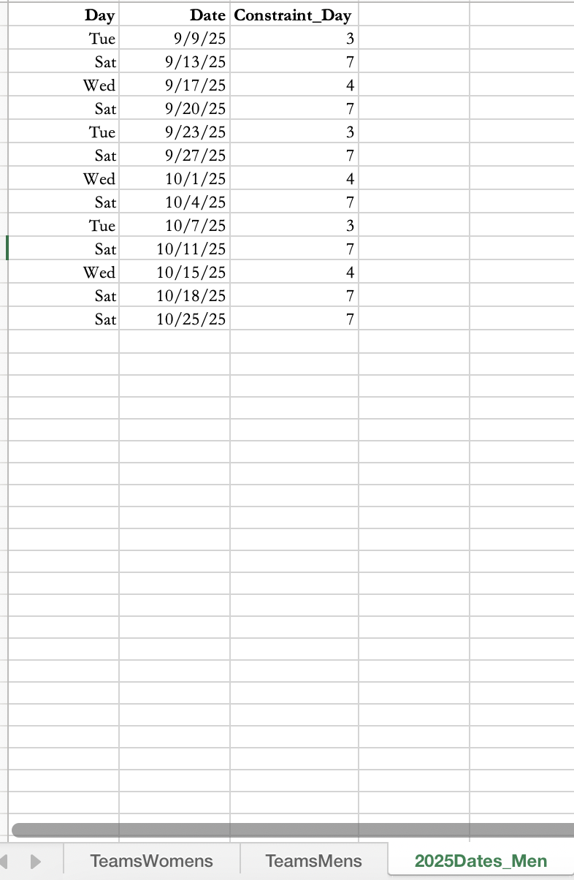
Setting up
Teams
Special Dates
PlayDates

Slide 5
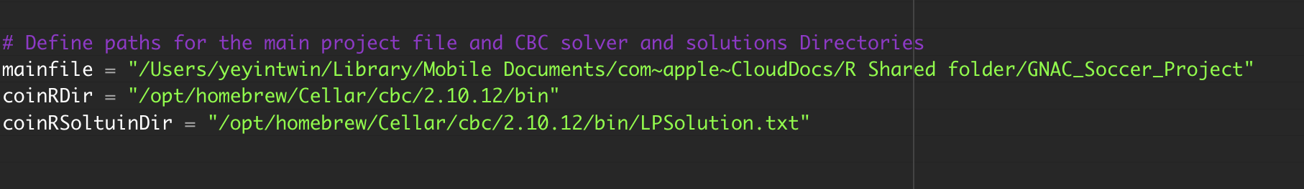
Setting Up Directories

Slide 6

Model Constraints
Balancing Home & away games (>=5 games)
Each team only play once per available playdate either home or away.
A team should play only once with a specific opponent either home or away in a season.
No more than three consecutive home or away games per season
Total Men’s games per team = 12
Total Women’s games per team = 13

Slide 7

Implementation
Separate Men’s and Women’s files.
Optimization is to maximize the Special Date Satisfaction at home games as per requested. The satisfaction is 5 for either man or women playing at home on the special date and zero if they don’t.
Create readable schedules in Excel or CSV formats for a regular soccer season in a short amount of time.
Adaptable to any number of teams, dates, or special date requests.

Slide 8
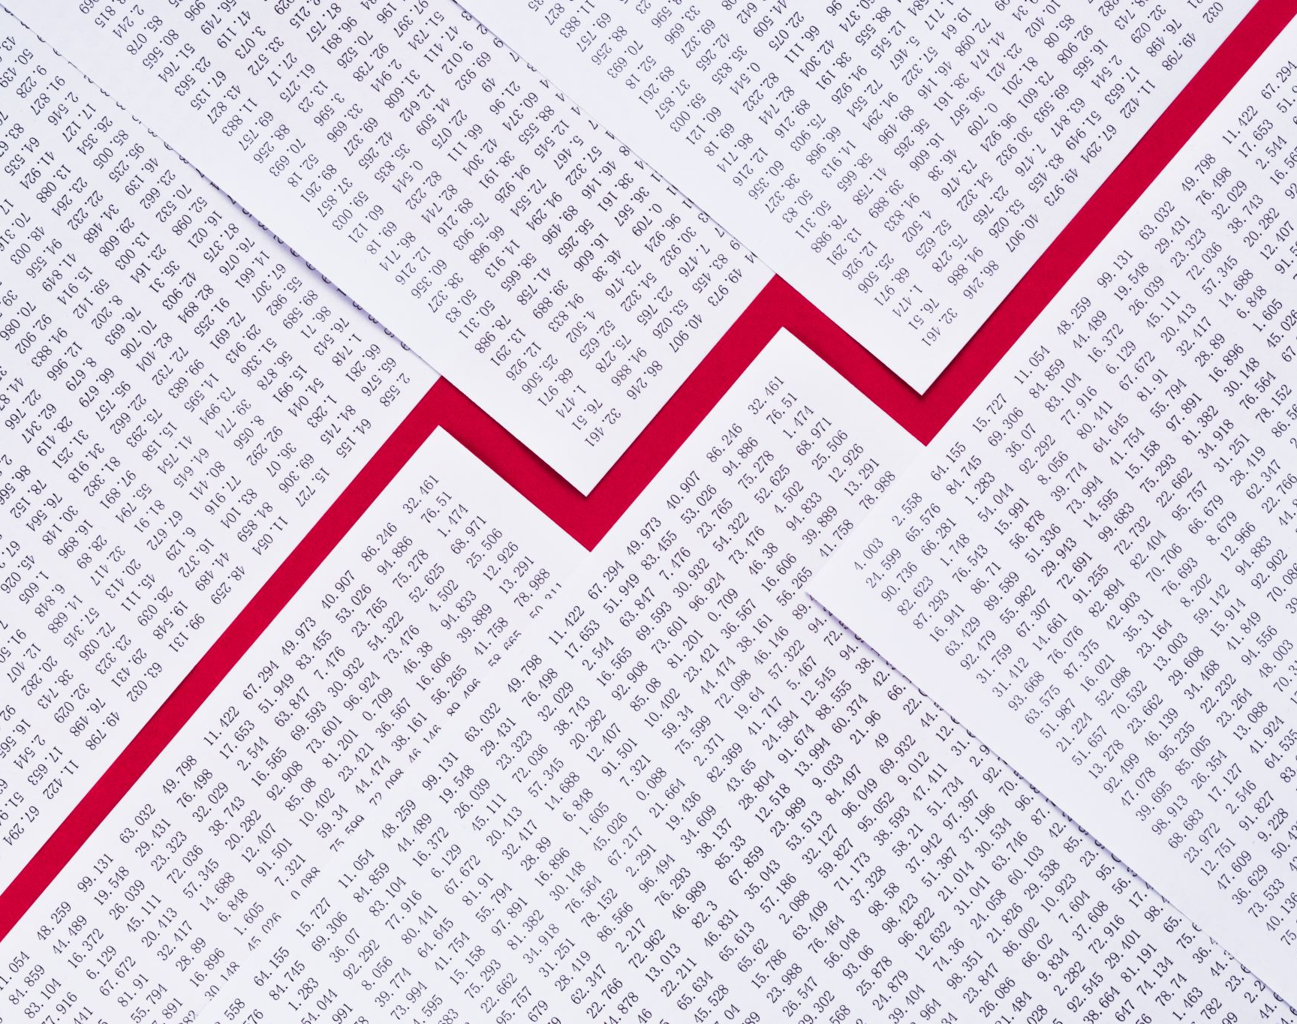
Results

Slide 9
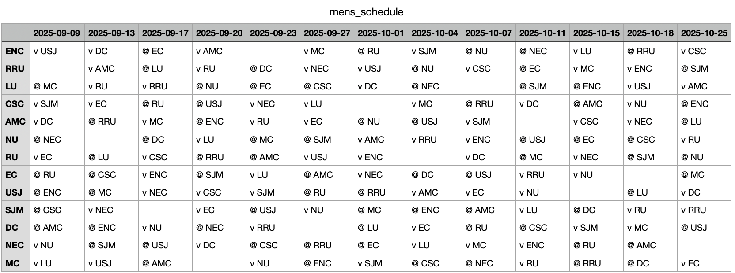
Men’s Schedule
V = Home Games
@ = Away Games

Slide 10
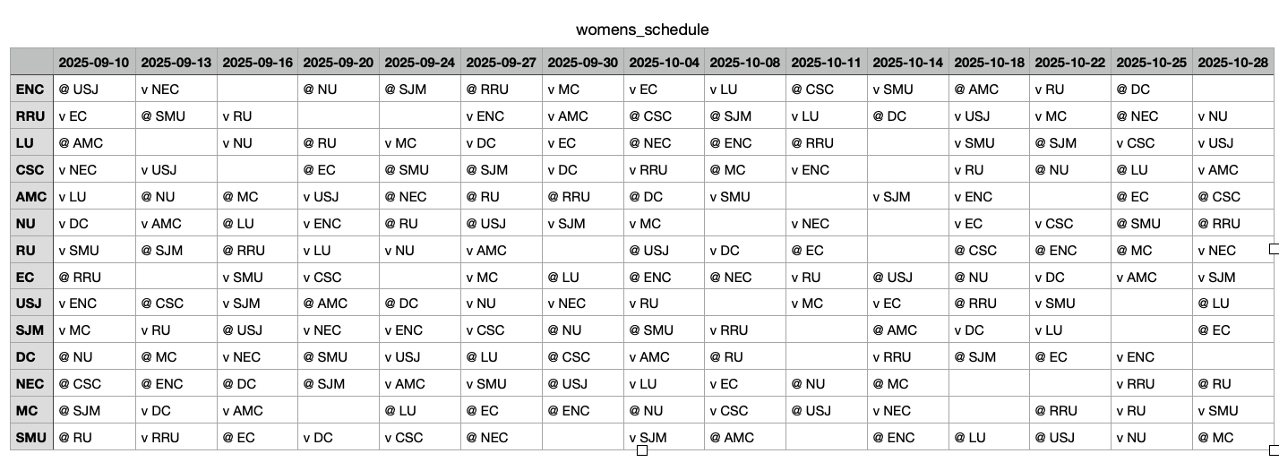
Women’s Schedule
V = Home Games
@ = Away Games

Slide 11
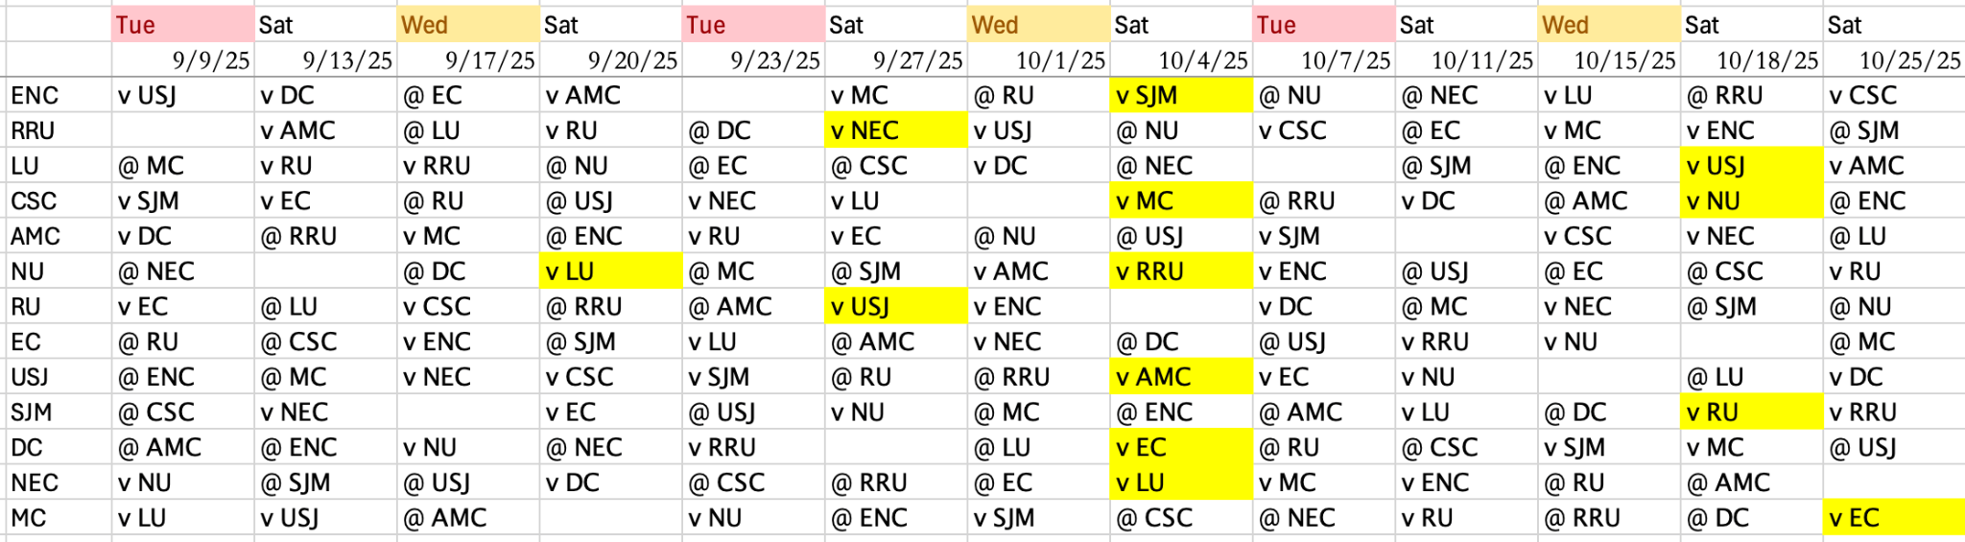
Men’s Schedule (Insights)
V = Home Games
@ = Away Games
Special Dates

Slide 12
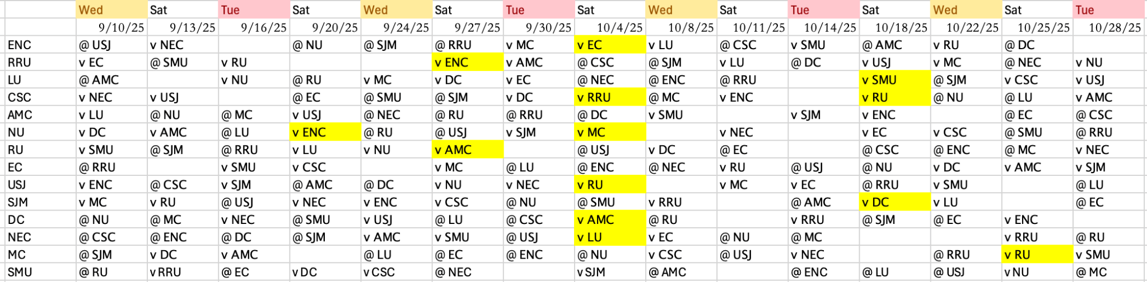
Women’s Schedule (Insights)
V = Home Games
@ = Away Games
Special Dates

Slide 13
Weaknesses
COIN-OR can be a little tricky to install.
Men’s and Women’s files are different due to different playdates.
They are independent of each other.
No consideration to travel or cost.

Slide 14

Questions?
Thanks For Listening

